Slide 1



Auto Market KPI Tracker
By : ASHLIN K V
2025.06.26

Slide 2

CONTENTS
1. Introduction / Objective
2. Key KPIs Summary
3. Market Trends Over Time
4. Brand & Model Insights
5. Insights & Observations
6. Conclusion / Recommendations
7. Thank You

Slide 3

Objective
This dashboard provides key insights into car listings, including price trends, brand performance, and model popularity. It aims to support data-driven decisions in the automobile market.
SOURCE “https://www.kaggle.com/datasets/syedanwarafridi/vehicle-sales-data”

Slide 4
Key KPIs Summary
• Avg Price of a Car: ₹13.7K
• Transmission Split: 97.13% Manual, 2.87% Automatic
• Price Range Distribution (e.g., 99.40% below ₹50K)

Slide 5
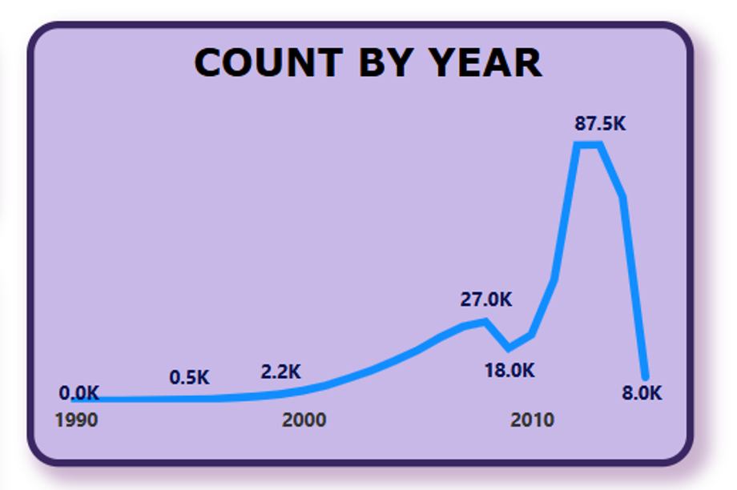


Market Trends Over Time
• Growth after 2000
• Sharp rise around 2010–2012
• Drop after peak
• Demonstrate how market activity has evolved.

Slide 6
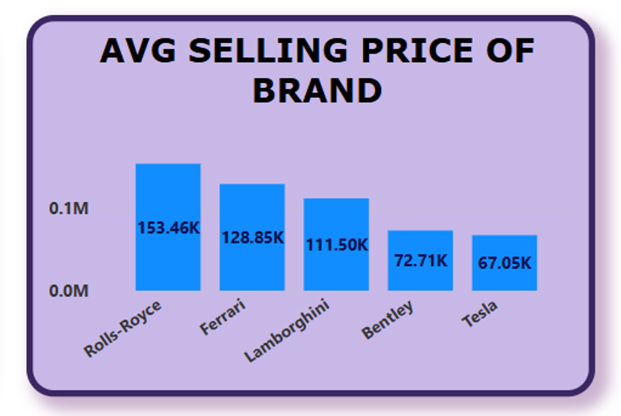
Brand & Model Insights
Average Selling Price by Brand
• Rolls-Royce: ₹153.46K
• Ferrari, Lamborghini, Bentley, Tesla
Top 5 Models
• Altima, Fusion, F-150, Camry, Escape (with listing counts)
Goal
• Identify which brands are premium and which models are most listed.

Slide 7
Insights & Observations
• Manual cars dominate the market (97% of listings).
• 99.4% of cars are priced below ₹50K.
• Rolls-Royce and Ferrari lead in average pricing.
• Listings peaked around 2017–2018.

Slide 8
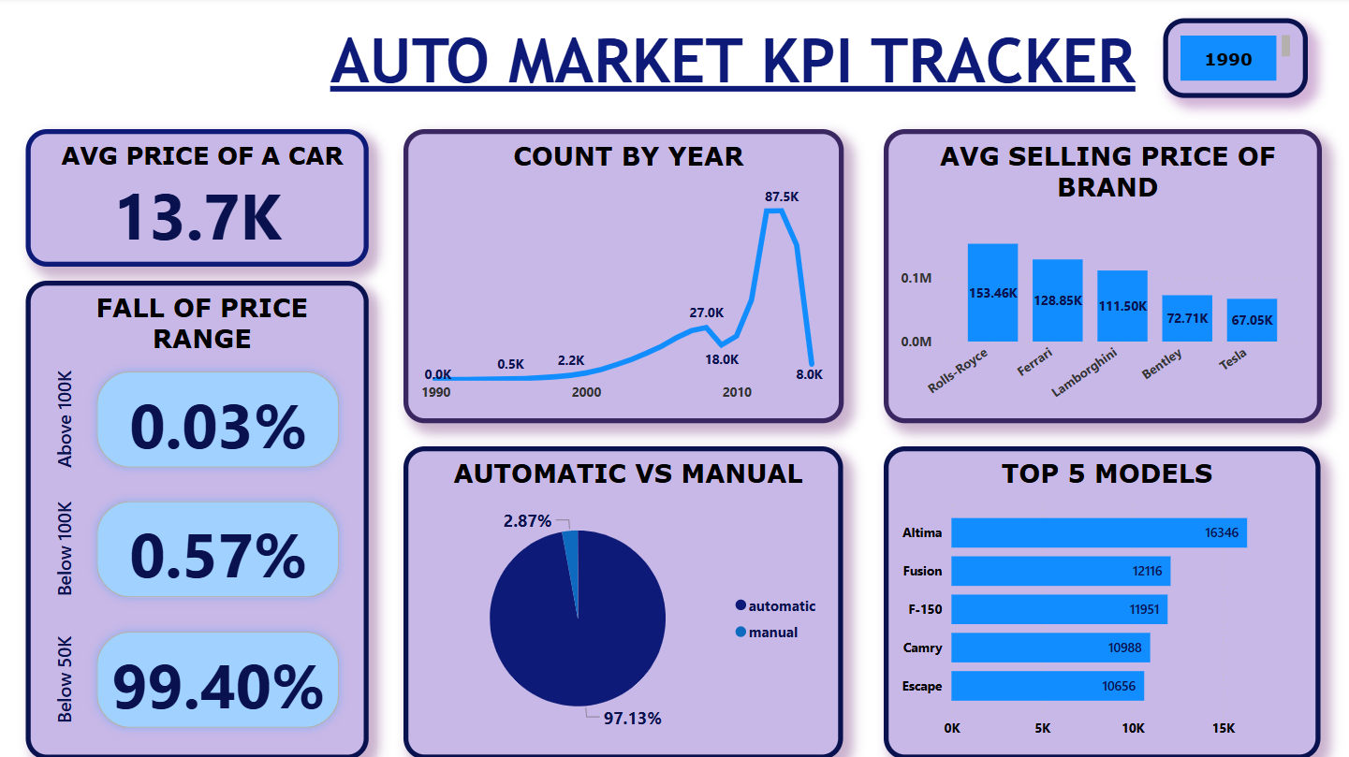
DASHBOARD OVERVIEW

Slide 9
Conclusion / Recommendations
• Key conclusions “Market is dominated by low-budget manual cars”
• Data suggestions:
• Focus on affordable listings
• Explore opportunities in automatic cars
• Use popular models for targeted campaigns

Slide 10

Thank You

